Slide 1





Indian Institute of Technology Madras
BUSINESS DATA MANAGMENT CAPSTONE PROJECT
DATA-DRIVEN RETAIL OPTIMIZATION:
OPTIMIZING INVENTORY & MARGINS AT PURE’O NATURALS
PRESENTED BY
Vishal Bhandari 22f1001645

Slide 2


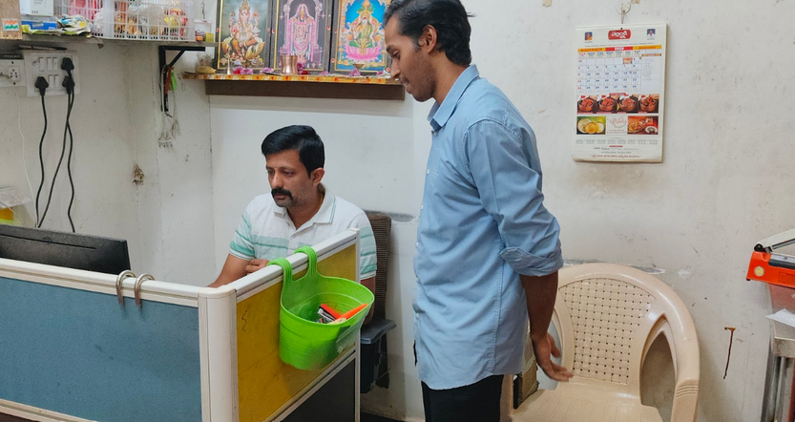
BUSINESS
CONTEXT
"I don’t really look at the numbers much -
things seem okay".
"A ₹2.5Cr Business Running on Intuition, Not Data"
🏬Scale
40+ outlets (Hyderabad) ; Anjaneya Nagar branch since 2018 ; Health - conscious urban consumers.
We’ve been running this as a profitable business for years. It’s a family business - there are no gaps
📦Operational Complexity
960 unique SKUs (analyzed period) ; 52,314 transactions (6 months) ; 450 daily footfall coverage ; Fresh Produce + cold pressed juices.
💰Revenue Scale
₹2.54 Crores (Apr-Sep 2025); ~₹5 Cr annual projection ; High-velocity perishable business model
❌ Critical System Gaps
No centralized SKU profitability tracking; No pricing controls or POS restrictions ; Family-committee governance (slow)

Slide 3



THE THREE PROBLEMS
Three Operational Inefficiencies Eroding ₹48.6L Annually
Problem 1: Portfolio Chaos
Problem 2: Margin Erosion
Problem 3: Volatility Risk
The Issue:
821 SKUs (85.7%) generate only 20% revenue.
Yet consume ~70% shelf space
Root Cause:
No SKU rationalization; legacy products accumulate
Financial Impact:
₹21.7L working capital trapped in tail
₹2.3L slow-mover loss
👉 ₹24L ANNUAL RISK
The Issue:
869 SKUs (90.5%) operate below 20% margin floor
Root Cause:
Manual costing + no margin guardrails
Financial Impact:
₹22.4L monthly revenue below margin floor.
₹5.1L pricing leakage
👉 ₹15L ANNUAL RISK
The Issue:
746 SKUs (77.9%) exhibit extreme demand swings
CV > 25%
Root Cause:
Flat 10% safety stock policy fails under volatility
Financial Impact:
₹4.8L annual stockout loss
₹2.0L shrinkage
👉 ₹9.6L ANNUAL RISK

Slide 4




STRATEGIC OBJECTIVES &
EDA APPROACH
2. Recover Lost Margins (Fixing the Leak)
Objective
Ensure margin discipline across the entire product portfolio.
Target
Improve overall portfolio margin from 21.4% → 23.0% (+1.6% uplift).
Action Mechanism
Tiered repricing of 869 SKUs operating below the 20% margin floor.
Analytical Approach (EDA)
Price Variance Index & Margin Proxy Modeling to flag pricing inconsistencies and identify margin-at-risk SKUs.
1. Rationalize the Portfolio (Taming the Long Tail)
3. Stabilize Inventory (Managing Volatility)
Objective
Eliminate non-performing SKUs to free shelf space and working capital.
Target
Reduce active SKU base from 3,247 → 1,800 (44% reduction) within 12 weeks.
Action Mechanism
Phase out 1,447 low-impact (“Zombie”) SKUs contributing <5% of revenue.
Analytical Approach (EDA)
ABC Analysis (Pareto Principle) to identify the Critical Few SKUs driving the majority of revenue versus the Trivial Many.
Objective
Align inventory levels with demand variability to reduce losses.
Target
Reduce stockouts by 68% and wastage by 24%.
Action Mechanism
Implement Dynamic Safety Stock
ROP = Mean Demand + 1.5 × Standard Deviation for high-volatility SKUs.
Analytical Approach (EDA)
Coefficient of Variation (CV) Analysis to quantify demand volatility and segment SKUs by risk profile.

Slide 5

DATA FOUNDATION &
METHODOLOGY
DATA FOUNDATION — DIGITAL TWIN
Direct EPoS Export
Apr 1 – Sep 30, 2025
Authorized by Branch 0007
183 Days (Full Seasonal Cycle)
52,314
Line-Item Level
Total Transactions (Verified)
Every SKU, Price & Date Stamp
METHODOLOGY MATRIX — RIGHT TOOL FOR THE RIGHT PROBLEM
PROBLEM
Portfolio chaos
ABC Analysis (Pareto)
Separates the "Vital Few" (20%) from the "Trivial Many"
PROBLEM
Margin Erosion
Price Variance (SPC)
Detects manual overrides &
inconsistent pricing patterns
PROBLEM
Volatility Risk
Normalizes risk to compare Apples vs. Almonds.
Coeff. of Variation

Slide 6
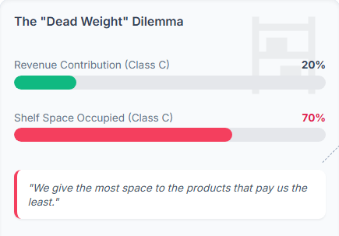
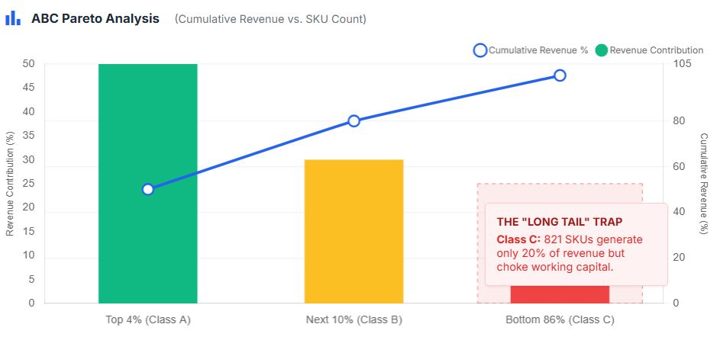
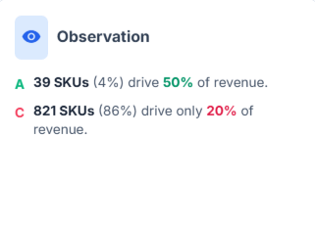
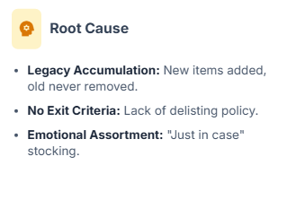
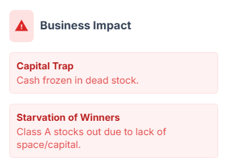
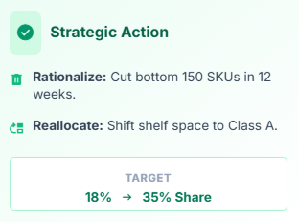
THE PORTFOLIO
EFFICIENCY GAP
Finding #1

Slide 7
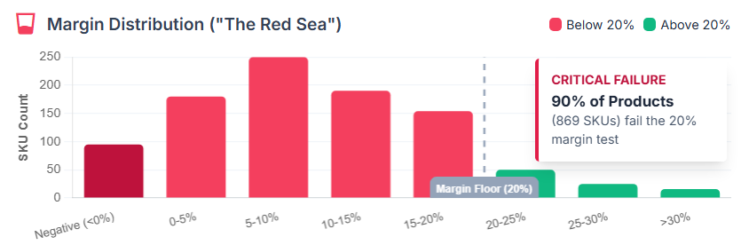
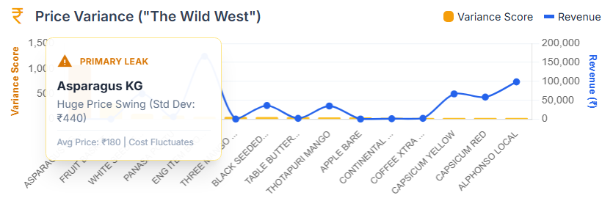
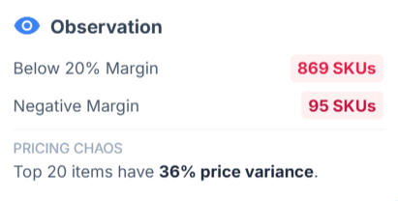
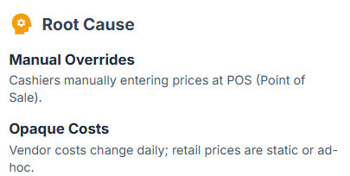
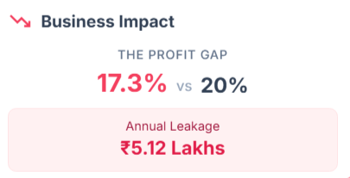
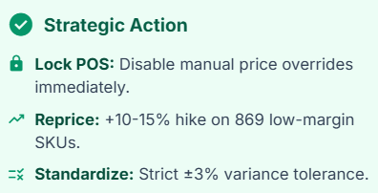
MARGIN EROSION &
PRICING LEAKS
Finding #2
High Volume ≠ High Profit: 90% of Portfolio Below Margin Floor

Slide 8
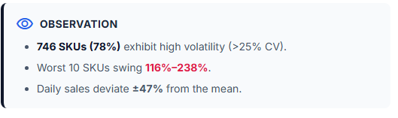
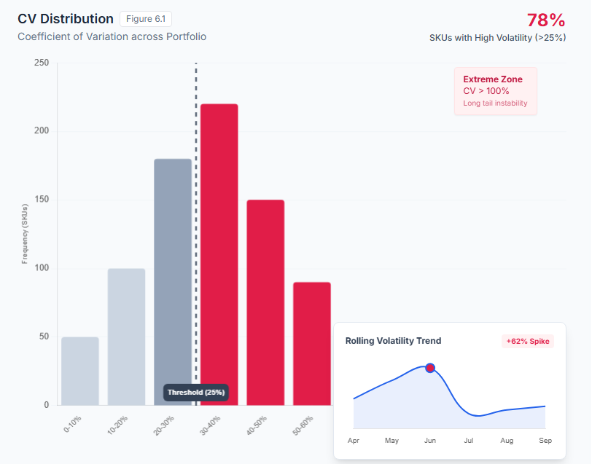
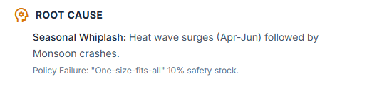
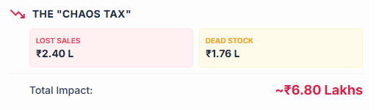
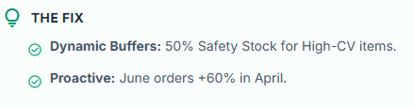
VOLATILITY RISK
(THE CHAOS TAX)
Finding #3

